Slide 1

Autonomous Car using a MPC
Jan-Ruben Schmid
Karol Szurkowski,
Nathan Durocher,
Vincenzo Coppola
Notes:
In our project we are going to deal with an Autonomous Car using a MPC. During this presentation we are going to discuss firstly the motivation of the project, then we are going explain how we implemented the model in Matlab and which pipeline was followed, and how we prepared the Gazebo world for a visualization of the simulation.

Slide 2
Motivation
Where am I?
What is around me?
How to drive?
Notes:
Three major components of autonomous driving are localization (where am I), perception (what is around me), and control (how to drive around). We can plan a trajectory for an autonomous car to follow. Then, we discuss the control of the vehicle’s acceleration, brake, and steering with Model Predictive Control (MPC) using a kinematic bicycle model.
The purpose is not only following a target trajectory as close as possible but also as smooth as possible to avoid motion sickness or frequent braking. The model simulation is done in Matlab. Afterwards the simulation results get imported into Gazebo to visualize the car on the track using a previously made CAD model.

Slide 3
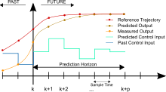
Overview of MPC
Estimate best driving experience
Smoothness
Safety
Efficiency
while keeping within physical limits (constraints)
Get current state from sensors
Predict and optimize controls over finite time horizon
Take only 1st step
Notes:
Our goal is then to estimate the best driving experience and that would mean reach the best smoothness, safety and efficiency as possible while keeping physical limits. MPC is a process to minimize costs while satisfying a set of constraints. An MPC works by using sensors to get the current state (speed, heading, position) of vehicle, we predict and optimize control over time horizon and apply controls from first prediction.

Slide 4
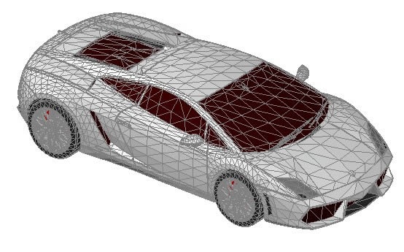
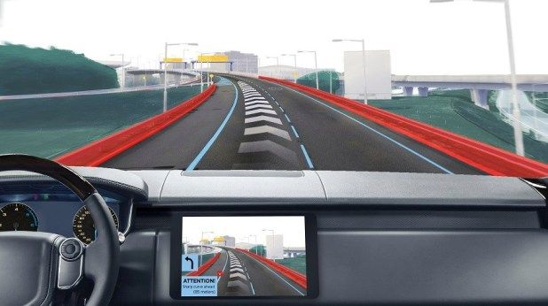
Our approach
Car Model
Path creation
Path following with MPC
Simulation in Gazebo
Notes:
To setup the optimization control problem for an autonomous car we first need to define our pipeline. We will follow 4 steps.
1. Firstly, we have to define our car model or state and that would men define how the car moves in the space and defines its position and orientation.
2. The second step will be “Path creation” that in our case is done clipping the track from QgroundControl (a tool for plan autonomous task for drones) and exported to Matlab for the control process.
3. In matlab we process the track to follow the planned path with MPC.
4. And finally we export the created track in Gazebo for a visualization in the simulated world.
Path planning (Full track)
Follow the planned path with MPC
Create subset of path -> polyfit
Follow the subset as close as possible
How to define the “goal” and how its updated as the car moves
In following we describe both

Slide 5
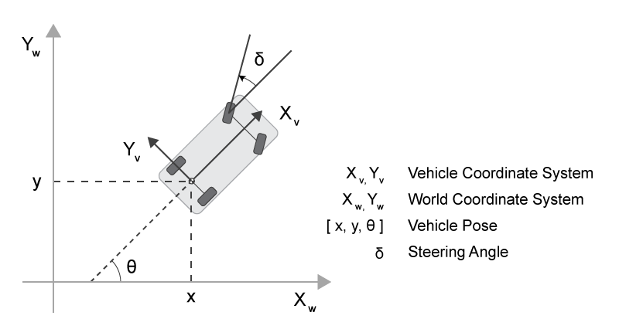

Spatial Parameters
$$\left(\begin{matrix}x′ \\ y′\end{matrix}\right)=\left(\begin{matrix}\cos{θ} & sinθ \\ −sinθ & \cos{θ}\end{matrix}\right)\left(\begin{matrix}x \\ y\end{matrix}\right)$$
Notes:
To answer the question of where we are in space we define the state of the car. This is done by setting a global position and orientation of the vehicle, this would be similar to a GNSS location and a heading direction from a compass. The orientation will defines the direction of the velocity of the vehicle. Lastly to simplify the path planning problem we define a vehicle coordinate system to shift the problem to deal with relative distances and account for the orientation.

Slide 6
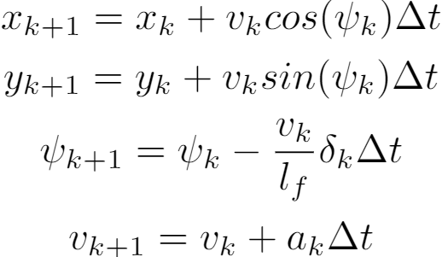
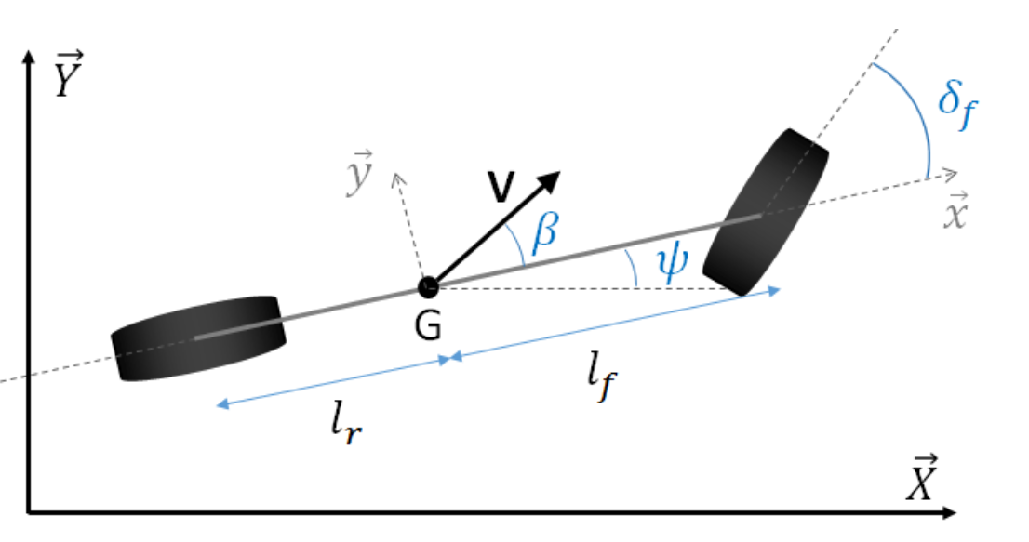
Dynamic Model
Notes:
Next we need a way to represent the vehicle motion, here we use the kinematic bicycle model commonly used along with MPC for autonomous vehicles motion control. Such a model can be expressed as: Where x and y are the position of the vehicle in its local frame . v the speed of the vehicle, psi the orientation, Lf is the distance from the front wheel to the center of gravity of the vehicle, and dt is the sampling time of the control system. The two controlled variables are the steering angle delta, the acceleration a. They will be the output from the MPC and will applied at the end of each timestep.
Answers the question of how to drive.

Slide 7
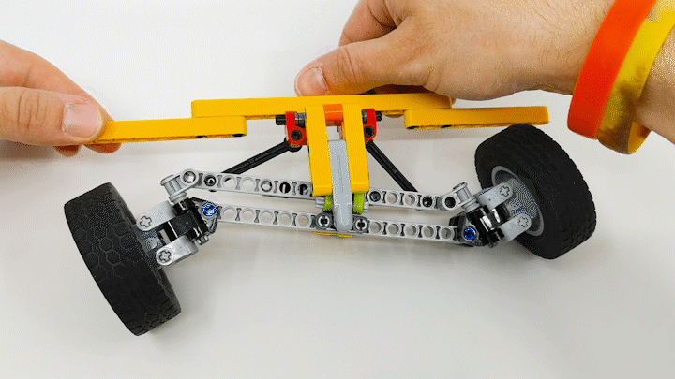
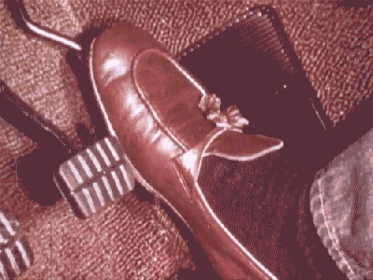
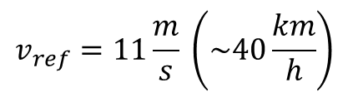
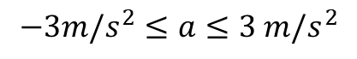

MPC – Constraints
$$−3m/s^{2}≤a≤3 m/s^{2}$$
$$−25°≤δ≤25°$$
$$v_{ref}=11\frac{m}{s} \left(\sim 40\frac{km}{h}\right)$$
Notes:
Next we need a way to represent the vehicle motion, here we use the kinematic bicycle model commonly used along with MPC for autonomous vehicles motion control. Such a model can be expressed as: Where x and y are the position of the vehicle in its local frame . v the speed of the vehicle, psi the orientation, Lf is the distance from the front wheel to the center of gravity of the vehicle, and dt is the sampling time of the control system. The two controlled variables are the steering angle delta, the acceleration a. They will be the output from the MPC and will applied at the end of each timestep

Slide 8
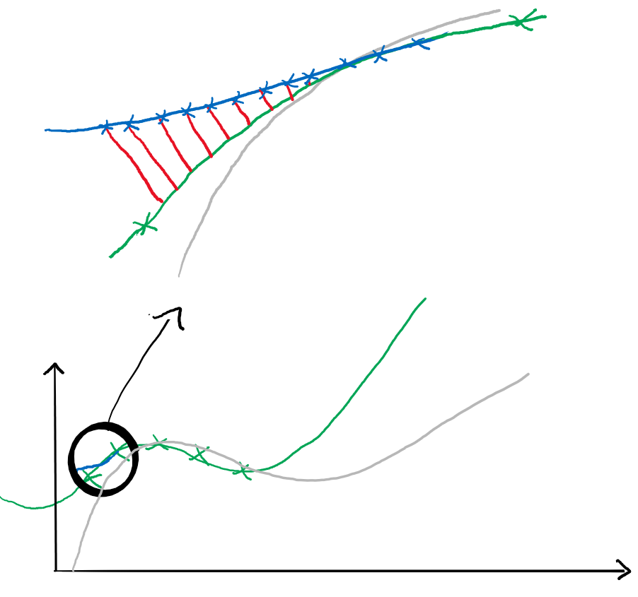
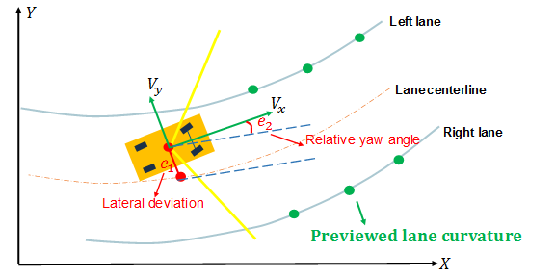
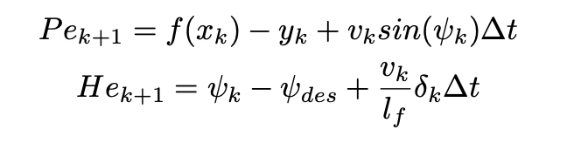
MPC – Path planning
Path
Polynomial fit
Optimized path
Path error
Notes:
After “where am I” we we are going to answer the question “What’s around me?”
Horizon – 12 points at 10 ms, 120 milliseconds ahead
Waypoint polynomial fit – 5 points each 40cm -> 2 meter ahead
Heading error
https://github.com/mithi/mpc
Timestep Length and Frequency
The timestep length N is how many states we "lookahead" in the future and the time step frequency dt is how much time we expect environment changes. We chose a dt = 0.1 seconds because the that's the latency between actuation commands so it seemed like a good ballpark. If the N is too small, this makes us too short-sighted which defeat the purpose of planning for the future. If the N is too small we might not be able to take advantage of looking ahead to plan for curves that we might not be able to do with simpler and less sophisticated control methods like PID. It doesn't make sense to look too far to the future because that future might not be as we expect it, so we must not calculate too much before getting feedback from the environment. Also, it will take a long time to look for the best move as I have set this to a time limit of 0.5 seconds (The default option from the mpc quizzes the code approach was modeled after). I started with N = 6 because that's the number of waypoints given to us but looking at the displayed green line at the simulator makes too short to plan for curves. At N = 15 I noticed that given the time limit of 0.5 seconds, it seems that the computer was running out of time to find the best variables that have minimized the cost well. With trial-and-error I found that N = 10 was good.
Polynomial Fitting and MPC Preprocessing
The waypoints to estimate the road curves is given at an arbitrary global coordinate system, so I had to transform them to the vehicle's local coordinate system. We used this to get a 3rd order polynomial as an estimate of the current road curve ahead, as it is said that it is a good fit of most roads. Using a smaller order polynomial runs the risk of underfitting, and likewise using a higher order polynomial would be prone to overfitting or an inefficient unnecessary added complexity.

Slide 9
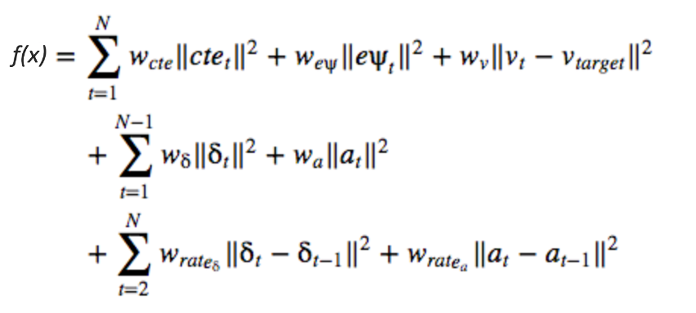
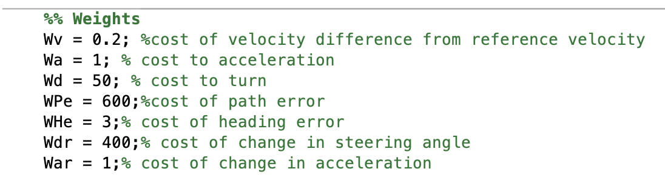
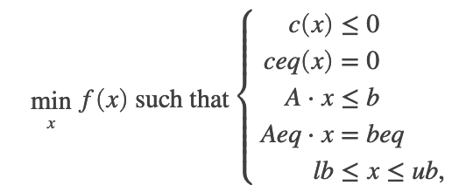
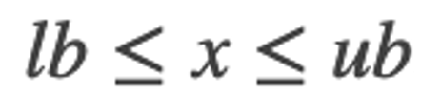

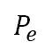
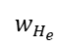


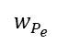
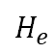
MPC – Cost function
$$w_{P_{e}}$$
$$P_{e}$$
$$w_{H_{e}}$$
$$H_{e}$$
Solve non-linear optimization problem
Notes:
Cost Function and Penalty Weights:
Given the constraints of our model, we should have a good objective such as a cost function to minimize.
Here are the factors we should consider:
We should minimize the cross track error cte, we want to be in our desired position
We should minimize our heading error epsi, we want to be oriented to our desired heading
If possible, we want to go as fast as we can. We set this to v = 100 but you can play around with this.
We don't want to be erratic in our driving IE:
We don't want to steer if we don't really need to
We don't want to accelerate or brake if we don't really need to
We don't want consecutive steering angles to be too different
We don't want consecutive accelerations to be too different
The penalty weights are again determined through trial-and-error, taking into consideration that our primary objective is to minimize cte and epsi so that should hold the highest weight. We also increased the weight cost for consecutive steering angles when We notice that the path that the vehicle was taking is somehow jagged. The least of our concerns is going as fast as possible. We also had to increase the weight cost a little bit for the consecutive acceleration difference because we don't want to turn too late at road curves.

Slide 10
Track Creation
Motivation
Reproducible results for MPC
Create different, comparable paths
Requirements
“Smooth” corners and turns
Fixed length between each waypoint
Implementation
Load path from QGroundControl
Add intermediate waypoints by linear interpolation
Choose waypoints with fixed length
Notes:
Load path (json) from qgroundcontrol, add intermediat setps by linear interpolation, than choose waypoints with fixed path length

Slide 11
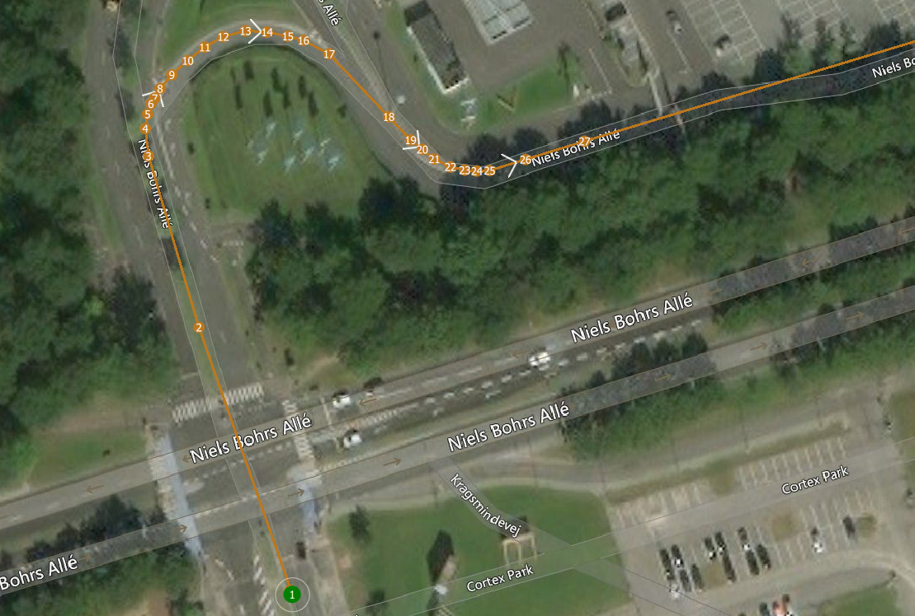
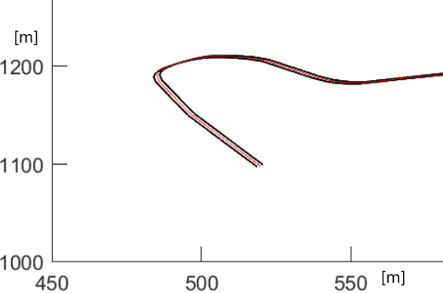
Track Creation
Notes:
Load track from qgroundcontrol in matlab -> done by python

Slide 12
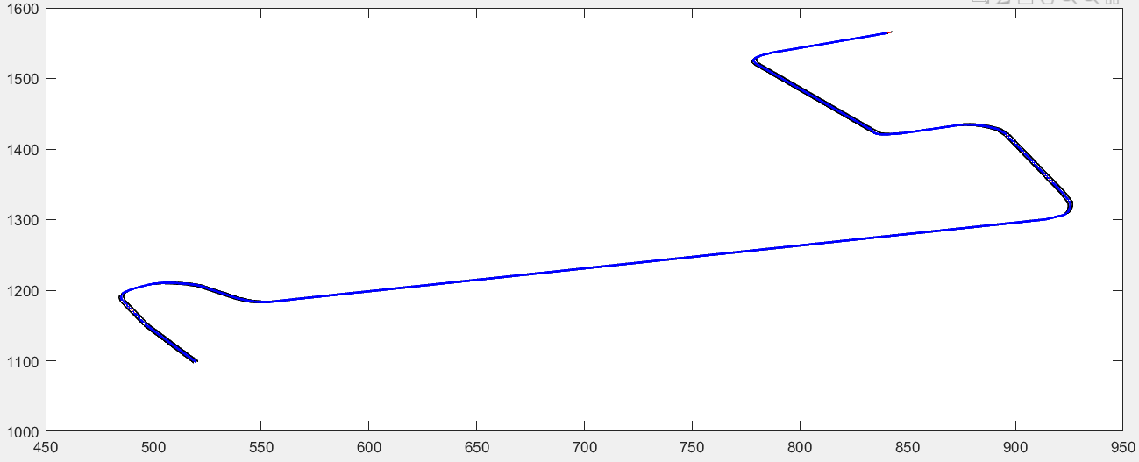
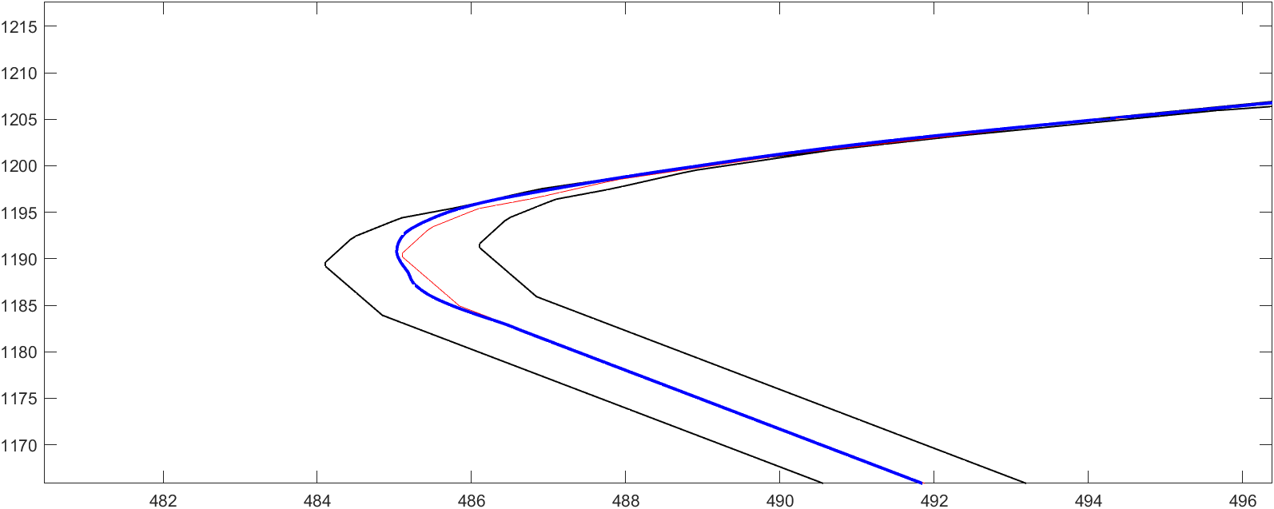

Results
Notes:
Results:
Track is smooth (red) and car follows well (blue). Black are width of street
Black lines debug reference and don’t represent a road

Slide 13
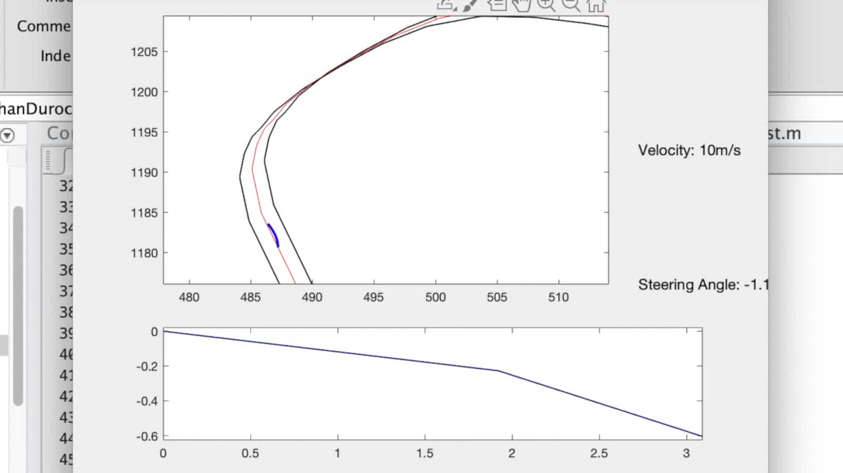
Notes:
Small below: polyfit

Slide 14


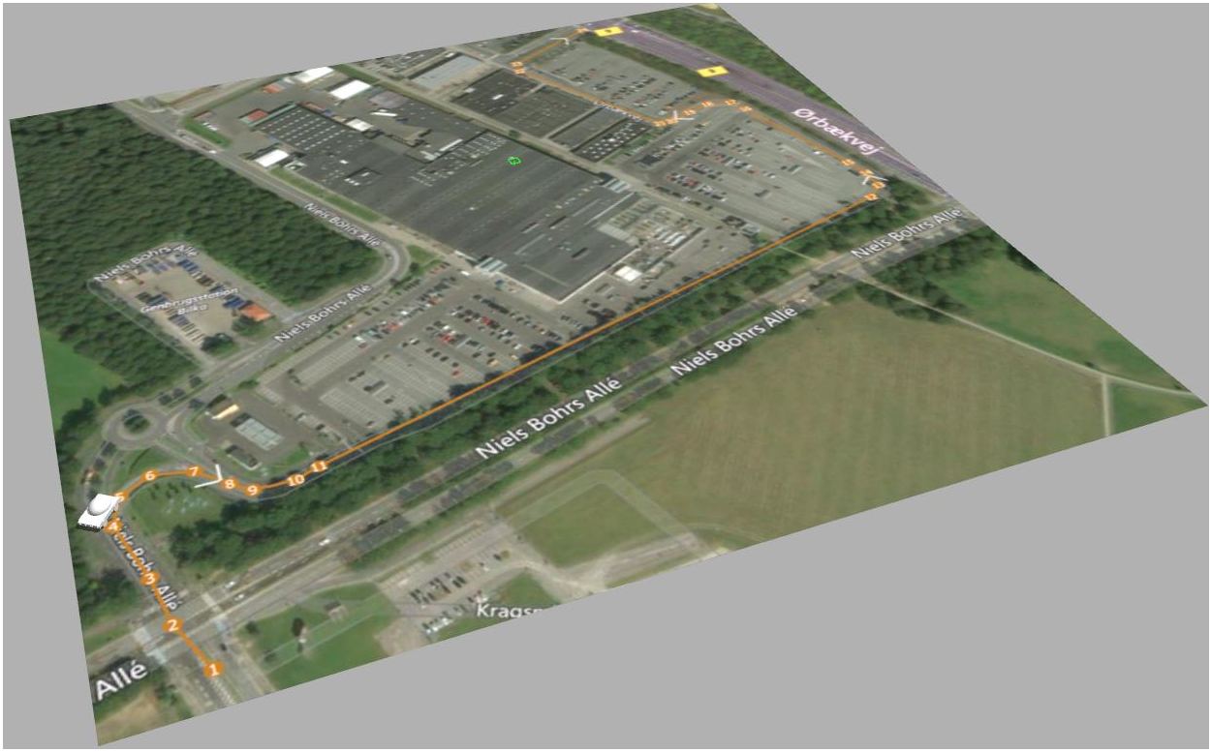
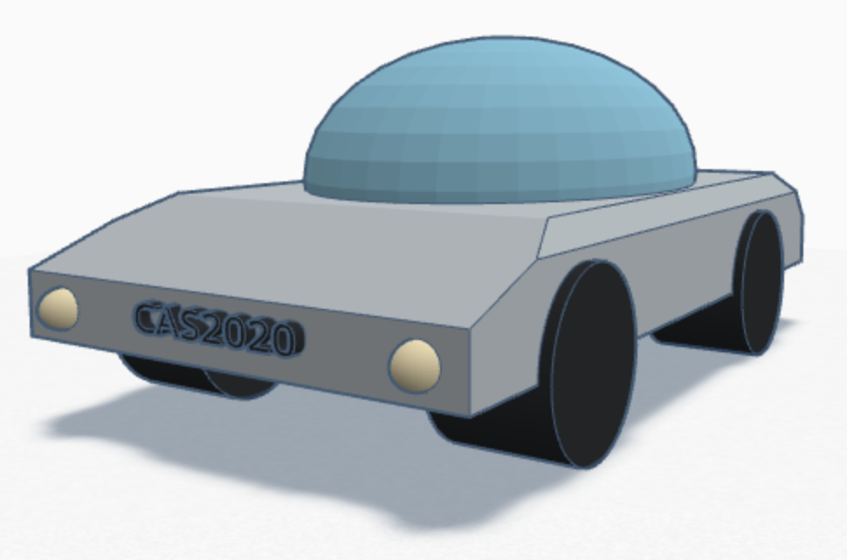
Simulation
Notes:
Knowing how a MPC works and how it was implemented in our project we can now put some light on the simulation.
In general simulations are very useful, they let developers to evaluate and test the robot in dangerous scenarios without taking unnecessary risks.
In our case we used ROS middleware with Gazebo simulation software for visualisation purposes alone.
In these pictures you can see the model of a car made in TinkerCad which is spawned in a Gazebo world picturing the track that we have used.

Slide 15
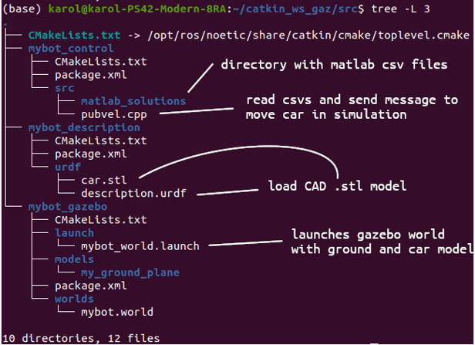
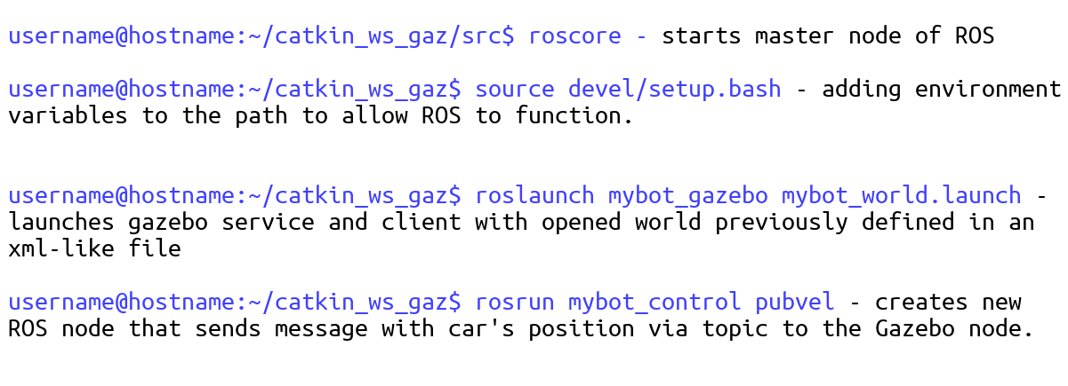
Notes:
In the picture on the left you can see structure of our ROS worskpace.
It consists of 3 packages which are:
mybot_description – consists of CAD model and an URDF file, which enables the model to be imported to Gazebo simulation.
mybot_gazebo is responsible for setting up default simulation world with spawned car model and the track.
mybot_control, which consist the main executable file of the ROS – Gazebo connectivity –> pubvel.cpp;
Having all those packages working and connected we can run the simulation with those 4 simple commands:
Starting the roscore
Adding environment variables by sourcing to actually run the nodes
Launching the gazebo world with car model and the map
Running the publisher node
Package – main unit for organizing software in ROS

Slide 16
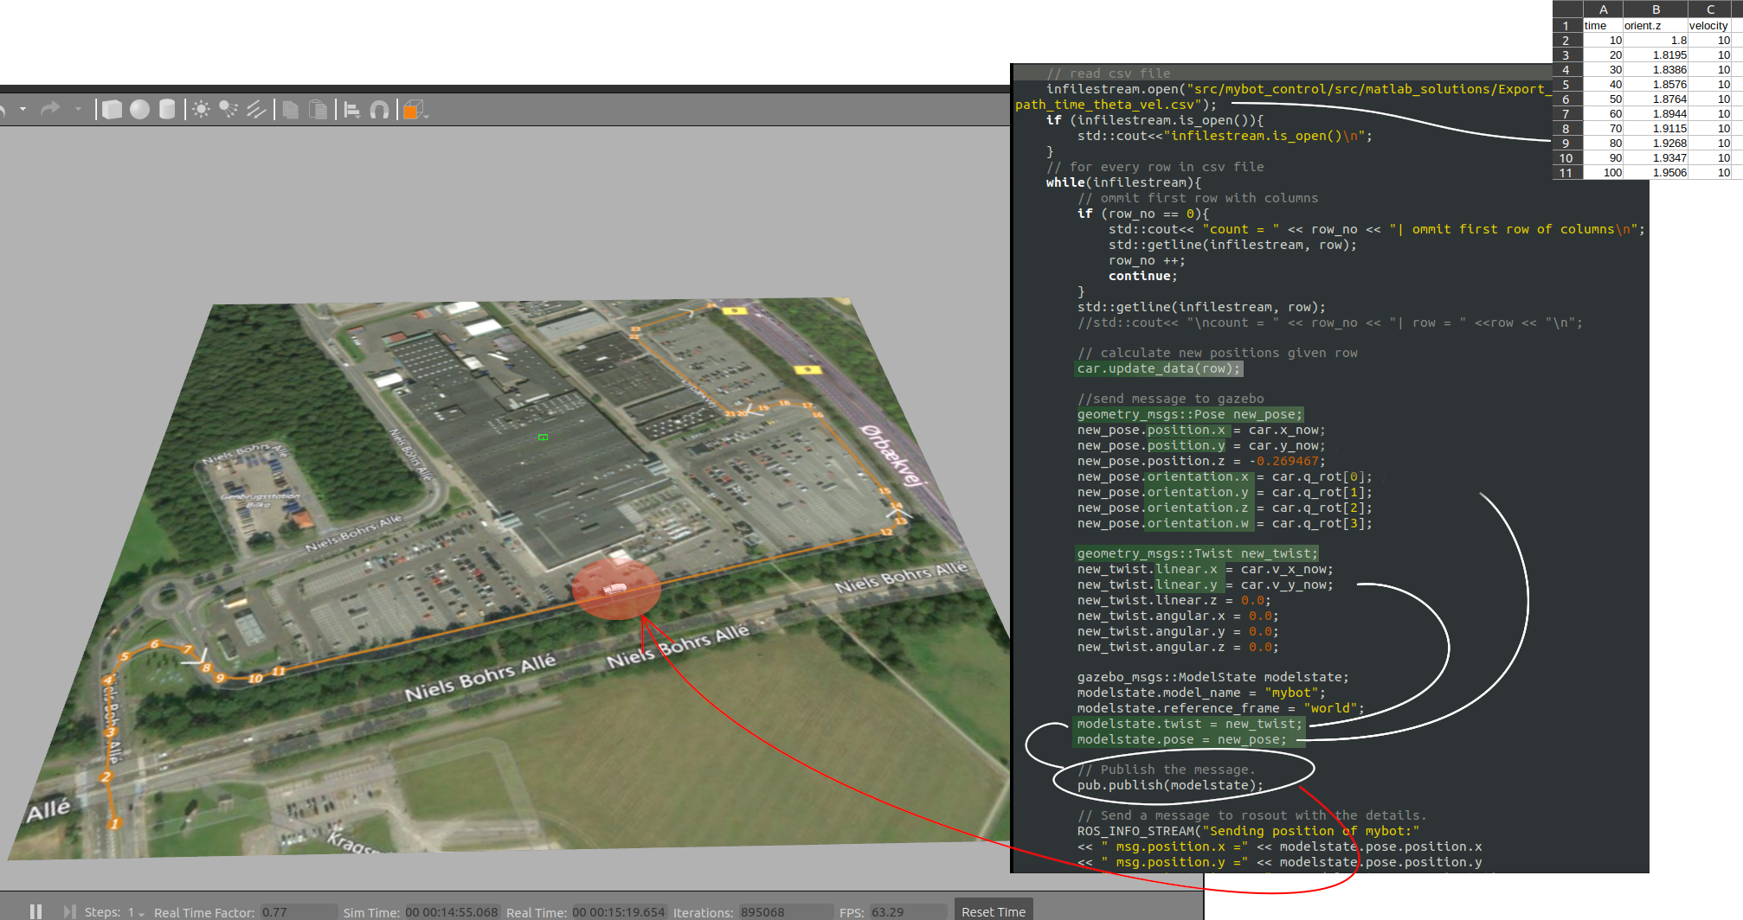
Notes:
This fragment of code is the pubvel.cpp file from the mybot_control package.
Since the results from matlab are saved in csv file with heading angle and velocity – the code reads the data, recalculates the position of car, and send it to the gazebo's model in an appropriate message type via publisher.
Then the car in gazebo receives its position and velocity updated with a high frequency what results in a smooth motion observed.

Slide 17
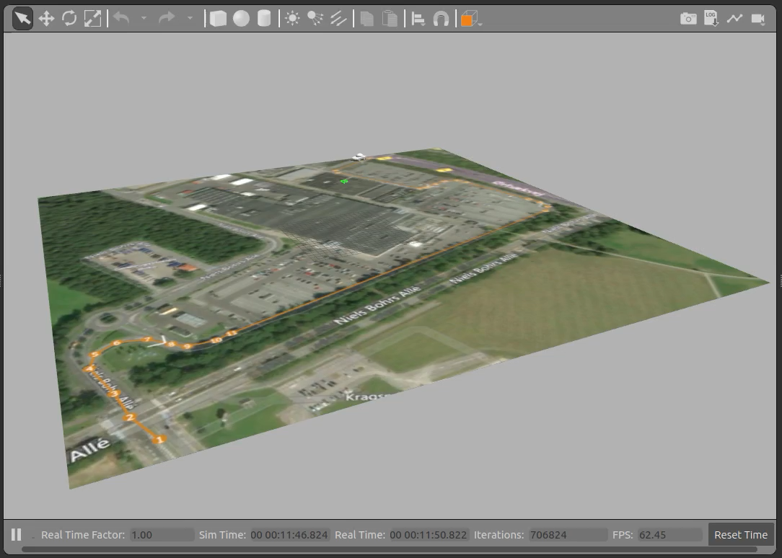
Notes:
Here you can see the car following the trajectory using MPC

Slide 18
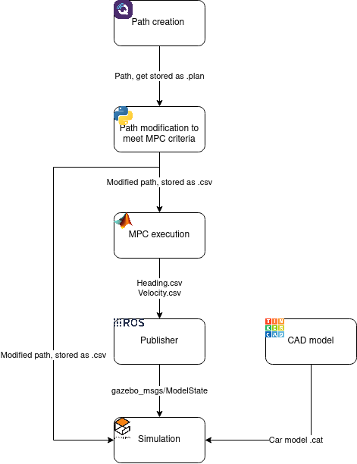
Summary
Notes:
Begin: create and preprocess data-> path creation and modification to meet requirements for mpc, store preporcessed data
Run mpc, export it to ros
Run simulation in gazebo/ros
Path creation with qgroundcontrol – take 60 waypoints and interpolate it with equal path lengths
Interpolate it with even distances using python script
Having the correct
Then export it to csv file that is used by MPC in matlab
The heading and velocities results are then saved and send by ROS to the Gazebo Simulation which moves the CAD model on the path.

Slide 19
Conclusion and Future Work
Successfully created a MPC
Further optimize the non-linear solver
Improve simulation to get closer to real world conditions
Add obstacle avoidance
Notes:
In conclusion, we can say that the result of our project is a proof of concept of a MPC controller.
Improve execution time by porting the project from matlab to C++ and using a more time optimized non-linear solver - such as CasADi
- In our simulation we are using a one assembly model that acts as a point in the space, to which we apply velocity in order to move in the space. In a future implementation we could add a complex model and apply physics to the steering, to do so we can use a differential drive in our model.
Finally, we could use actual measurement from a real sensor that could be also used to perform collision avoidance when we have obstacles in our route.

Slide 20

Thank you for the attention.

